Slide 1
Complain/feedback management system
a Web-service to minimize learners/visitors’ dissatisfaction

Slide 2
Details
Ministry Category : Ministry of HRD(NCERT+CBSE+NIOS)
Problem Statement : Online tracking and alerts system of complain received from the learners as well as visitors and the solution provided is required with alerts.
Problem Code :NIO3
Team Leader Name : Vikrant sharma
College Code: 161

Slide 3
Points to discuss
Introduction
Purpose
Collaboration and work plan
Concept
About existing system and description
Avoid common mistakes
Program goal

Slide 4
Points to discuss
Proposed model structure
system analysis
ER diagram
implementation analysis
design description
use case diagram

Slide 5
Points to discuss
scenario overview
sequence execution
Hardware and software requirements
Features of proposed system
Program scope
Project goals
Conclusion and future enhancement

Slide 6
Introduction
Today's development cycles for web-applications such as Portals are short, and getting shorter with continuous improvements and enhancements as new requirements and features become apparent.
Therefore, developing “Web Services” using the “Service-Oriented Architecture” paradigm is a widely accepted concept.
On the other side, most of user’s complaints are apparent when a system has inappropriate communication between the organizations, their employees and citizens. Poor communication can result in poor services or products being provided by the organization or Government.

Slide 7
Introduction
Whilst concentrating on the topic of complaint handling, organizations can achieve an efficient success factor by increasing their user satisfaction and their loyalty.
Every day learners complaint to staff of the service department because of feeling dissatisfied. No matter direct or indirect accusation to any staff, such as face to face complaint, telephone complaint, complaint letter, and message on the web, all the complaints should be accepted and properly cared for.

Slide 8
Introduction
In this paper the concept of e-complaint management system were explored first new model was presented afterwards the implementation of the new model was discussed.

Slide 9
Purpose
Each organization has its own definition for complaint. They define complaint related to the services they provide for users.
Learners/visitors complaining behaviour defined as the consequences of learner/visitors dissatisfaction, it has long been considered an important form of market feedback.
Complaint Management System is a system that can survey customer feedback about any organization.

Slide 10
Purpose
Best-practice organizations consider complaints as opportunities for improvement.
The institutions understand the link between complaint resolution and students loyalty and work hard to act immediately on problems that can be easily resolved.
User feedback can be considered as complaints and suggestions, which can be instrumented in the organization to improve its services and products.

Slide 11
Collaboration and workplan
Workplan of the project requires dividing of various project phases into a defined time scale for completion of project on time.
Planning and Scheduling are very crucial phase of project life cycle because the project successful depends on this.
A high or Low time estimation of the project leads to large variation in project overall cost estimates.

Slide 12
CONCEPT
Customer Complaint is important information reflecting customers sound and is a primary measure of customer dissatisfaction.
The presented model for the learners/visitors Complaint Management System will have the ability to minimize learners/visitors’ dissatisfaction and on the other hand it can encourage other learners/visitors to participate in controlling the quality of the service provided.

Slide 13
CONCEPT
The Proposed model aims to develop a digitalised framework for e-Complaint Web-based that targets the learners convenience.
The cycle starts with distribution of different services that are provided by institution. Those services are applied for different people based on their needs.
Due to different obstacles those services may not be applied in appropriate way. Therefore, a need for a system that could detect learners/visitor problems and provide them with suitable feedback is raised.

Slide 14
CONCEPT
Also, this paper describes the Complaint Management System oriented by Web-application which will be used by Citizens in order to make complaints about their dissatisfaction on provided services.
This system will be able to handle complaints by recording and giving feedback for each raised complaint.
Results of the study can be a good reference to find out users needs from e-complaint and the handling process of this complaint in the body of any organization.
Key-Words: -e-CRM, e-Complaint, Complaint Management System, Complaint Handling.

Slide 15
About existing system
Person must goes to municipality for his complaints.
All the arrived Complaints are submit to the Agent.
Administrator distribute complaints among different departments according to complaint type.
Employees solve the complaints and note the complaint status in books manually.
Dispatch officer check the books and reply the solved complaints.
Inquiry officer gives the current status information of complaints from the books.

Slide 16
Limitations
No quick data searching facility for useful Information
Employees manually search data about complaints, which
they required to process or in the case of inquiry reply.
No proper management of information
Data and useful application details are capped in physical file, which
itself are stored in data/record room. Record has most of file of
different department.
Conti…

Slide 17
limitations
Possibility of loss complaint Record
All complaints handled manually. So, there is possibility to loss of complaints record because of transferring Complaints record between different physical levels and also inattention of employees.
Lots of paper work
For single complaints, many documents are need to be created.
students who come for Inquiry about his/her Application processing, have to Spend time for receive response because of manually check of processing Details.

Slide 18
limitations
Redundancy in data
There are possible to one complaint checked by one or more employee and same status reported by them. So there is possibility to data redundancy.
Time consulting problem
There is no proper management procedure for a complaint inquiry for people.

Slide 19
Proposed solution
The idea is to automate the entire complaint process from telephonic medium to electronic medium in order to increase efficiency and reduce the response time. There would be basically 5-6 main categories for the selection of complaint type. Then we will also provide the priority based on its severity for a particular complaint/issue. If the severity/priority is high then it would take a time of around 1 hours to 3 hours and if it’s having less priority then it would have one-two days’ time.
Validation is done for unique user id generation and registration
Validation of user id and password is done with user database
This would be having a student rules & regulations tab which would consist of all the rules mentioned in student constitution.

Slide 20
Proposed solution
A unique complaint number would be generated for a particular complaint. User would be able to check the status of his/her complaint.
Basically this would be a one stop solution for both learners to make authority aware of existing issue at a particular time.
Option of registering and signing up is available for first time users.
Return option is provided to cancel the registration process midway.

Slide 21
Proposed model structure
The proposed model is divided into 3-tiers that consist of the following:
Database – tier It contains data about system users and their Profiles, complaints, learner/visitor details, feedback, and workers detail.
Service – tier It consists of the core of the system. i.e. complaint and feedback components.
Presentation – tier It consists of web-based user interface.

Slide 22

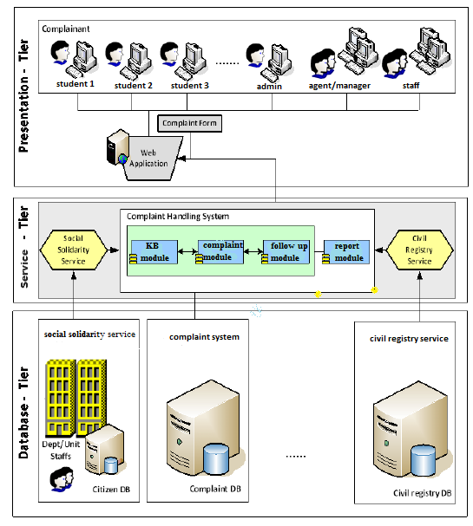
The proposed system
could be generally
Applicable for any
web-based e-complaining system .
Proposed Model for e-complaint handling system

Slide 23
System analysis
The development of the proposed model is not only depending on how the system works.
It also depends on the working flow process that being identified and need to be implemented and followed.
The proposed complaint handling model is a method, platform or web-application to ensure that the complaint process is addressed and handled properly.
Figure shows the main processes in the working flow process of the proposed model.

Slide 24
System analysis
First, verifying the learners validity, then creating the learners complaint followed by a detailed processes to manage each complaint according it’s classification priority and searching in the knowledgebase for related reference or similar case in order to find a quick handling procedure for finding a solution with the contribution of the responsible staff who will be dedicated to identify the rules on how to solve and get appropriate solution.
In this proposal we try to develop a model in terms of electronic complaints, which can support complaining from poor service quality.
The advantage behind this model is the simple method for handling the learners complaints about what dissatisfies them.

Slide 25
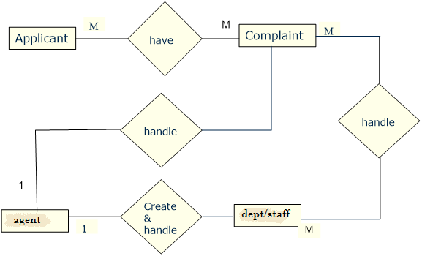
Entity relationship diagram

Slide 26
Implementation design
After explaining the working flow process and the proposed model, the next step is the implementation of the system as follows:

Slide 27
Design description
The complaint registration and resolution model has the following major modules.
Sign Up/Login (for All Users) Module: Sign Up page contain four fields: Verification field is used to check the genuinity of user and other three fields are User ID and Password and Confirm Passwords. Login age is expected to contain two mandatory fields: User ID and Password, along with 3 radio buttons that will indicate whether the user is a Student, Faculty Member or the Administrator.
Complaint Registration Module: This page shall allow the users to create new queries or go to a page that provides the status of an existing query. This page shall contain the Specific Field pertaining to the query. It shall also allow the user to decide on the priority of the notification. A high priority complaint is expected to be solved in a few hours. Medium priority is expected to get solved within a day whereas allow priority complaint is expected to be resolved in 2-3 days. This is followed by a dialogue box that enables the user to give a detailed description of the exact nature of the complaint. When the user clicks on Submit, he is guided to the next page with a unique Complaint Registration Number (CR No.)

Slide 28
Design description
Complaint Status Check: This page can be reached from Page 2 or Page 3. It has one mandatory field of complaint registration number (CR No.) which, when submitted, provides the information on the status of the query as Under Process or Finished.
Complaint Resolution Module: This page shall contain the list of queries along with their priorities and department to be referred to, status as per the department. The queries with finished as the final status are automatically moved to the solved sheet. The agent/manager can click on the status field of each query except his own complaint. This page shall contain the details about the status of the query like Finished or Pending or Unallocated. The Agent can change the Present Status of the query.

Slide 29
Design description
For Master Administrator:
Master Mode: There is only one master administrator who generates the verification code for sign up process and has the ultimate power to control the total system. He can manage complaints and has the ability to remove complaints from the database regardless of the complaint status.

Slide 30

Use case diagram
Roles:-
▪ Admin- Create system users and manage their privileges,
▪ Learner- Make Complaints against the provided Services
▪ Agent- Record the Complaint in the web-based then assigns follow up to available staff,
▪ Staff- Manage the Complaints causes and actions in the system then provide solutions,
▪ student registry- Has all learners SSN, Name... etc,
▪ Social Solidarity- Has Citizens details that deserve services,
▪ Staff Data- Has all staff details who works on Social Solidarity and could be assigned to deal with Complaints.

Slide 31
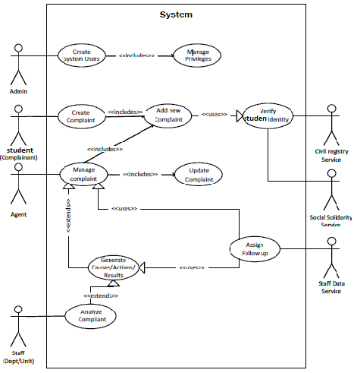
Scenario overview
A student encounters a problem with the Social Solidarity; he enters the web and fills his new
complaint in the complaint form, and explains his problem.
Then the agent/manager records the problem; opens the complaint system and enters information on each failure associated with the complaint.
In a subsequent process the staff of the service department handles the complaints and delegates each complaint to the responsible one. Each department deal with the assigned complaints according to the management rules then analyses actions and causes to get results.
After that, propose a satisfying solution for the student’s problem. If this solution is satisfactory for the student then the statement of the complaint is closed. If not, the responsible department edits the original complaint and the process starts again.
The new Complaint Management System is needed to improve these workflows and enable each department to contribute to the process of solving the complaints.
.

Slide 32
Sequence execution
For more understanding, we have summarized the flow of the major functions of the system using the sequence diagram to show how processes operate one with another and in which order.
The major functions of this system need to answer the following questions as:
Which type of users deal with it?
Who manage the system users and assign roles?
Who make the complaint?
Who deal with each complaint and according to which criteria?
Who solve the complaint?
Who follows up each complaint?

Slide 33
Sequence execution
First user: the administrator who adds new users or manages system privilege for whom exist on he system by assigning their roles.
Second user: the learner (complainant) who makes complaint and check for existing complaint status.
Third user: the agent who registers or manages learner Complaint each according to its weight classification and follows up through knowledge base in case of solution not found then forward the complaint case to the responsible staff of the service department to handle it.
Fourth user: the responsible staff of the service department who deals with the waiting complaints by identifying and analysing the causes and actions for each complaint then resolving it according to the management rules and propose a preventive action in order to ensure that this complaint will not be raised again. Then finally, back the complaint case to the agent in order to follow it up. After that, the agent updates the complaint status or closes the complaint case if it resolved.

Slide 34
Sequence execution
Also there are two main services that integrate with the proposed system,
First service: the Social Solidarity service which contains the entire learners’ information that deserves the services , also it contains the entire staffs’ information, each according to his department and role to deal with cases on the system.
Second service: the Civil Registry service which contains the entire learners’ identity information, if they deserve services or not, also to validate the identity of the learner who make complaint in order to improve the provided service as general

Slide 35
HARDWARE & SOFTWARE REQUIREMENT
Hardware Requirements
Processor :- intel core2duo
Speed :- 3.06 Ghz
Primary Memory :- 512 MB RAM
Hard Disk :- 2GB
Software Requirements
Language used :- html
Platform :-Windows XP/7/8/8.1/10
Tools Used :-Internet explorer, Mozilla Firefox, Chrome.

Slide 36
Features of proposed system
Fast & Dynamic Data
Latest Data can be fetched.
Automatic Reply.
Ajax Controls will be used for that Purpose.

Slide 37
Project scope
Receiving people complaints and Provides people complaint status.
Higher speed of Receiving complaints.
Distribution of Related complaints among Different Departments.

Slide 38
Program goals
The presented model for the learners/visitors Complaint Management System will have the ability to minimize learners/visitors’ dissatisfaction and on the other hand it can encourage other learners/visitors to participate in controlling the quality of the service provided.

Slide 39
CONCLUSION AND ENHANCEMENT
Conclusion :
This paper presents an overview of the development and implementation of the Complaint Management System as a web-service.
Complaints and compliments are valuable source of information that organizations can use to improve program delivery and service.
The preferred alternative is a customer-focused complaints management solution that works.
Finally the researcher believes that the presented model can be helpful in other fields of e-complaining in terms of learners Adaption and learners Loyalty.
.

Slide 40
Future Enhancements :
Due to the lack of time, the design part is not done so attractive.
Further Enhancements can be made in designing the UI.
Some more mechanisms can also be added so as to better retrieve the details.
Various other options can also be added for the better usability of project.

Slide 41
Team members
Varnit rohilla
Vikrant sharma(team leader)
Mehak Aggarwal
Kajal
Sunny Yadav
Shubham pandey

Slide 42
Thank you

